Slide 1



Bakery Branch Sales Prediction
Team Members:
Alex Anisimov
Henning Westphalen
Lucrezia Lamanna
Nawar Habboush

Slide 2
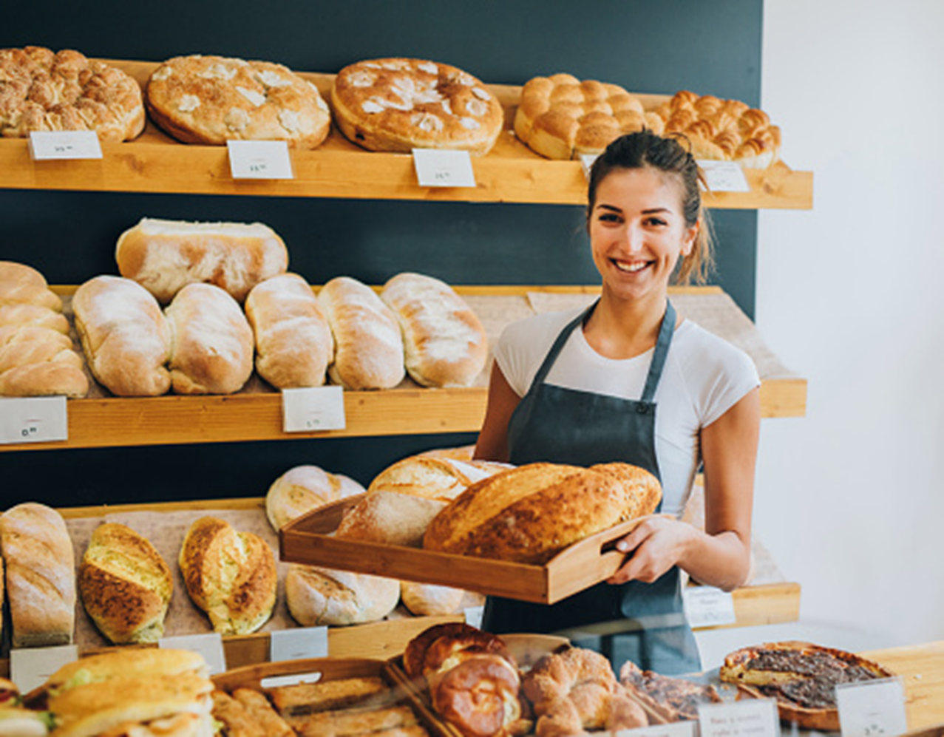
PRODUCTION PLANNING PROBLEM
?
How many loaves of bread to bake for the next week?
Can we sell more croissants on Mondays than on Tuesdays?
Do customers more bread on rainy days?
School holidays are coming. It seems like the demand for cakes…
And so on…

Slide 3
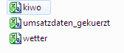



Data AVAILABLE
I need you data!
Dataset from 01.07.2013 till 31.05.2019 (2215 entries)
Sales of
6 categories:
1 Brot
2 Brötchen
3 Croissant
4 Konditorei
5 Kuchen
6 Saisonbrot
Data on weather conditions
Daily cloud cover (0: min , 8: max)
Daily average temperature (Celcius)
Average wind speed (meters per second)
Weather codes
Days of Kieler Woche

Slide 4
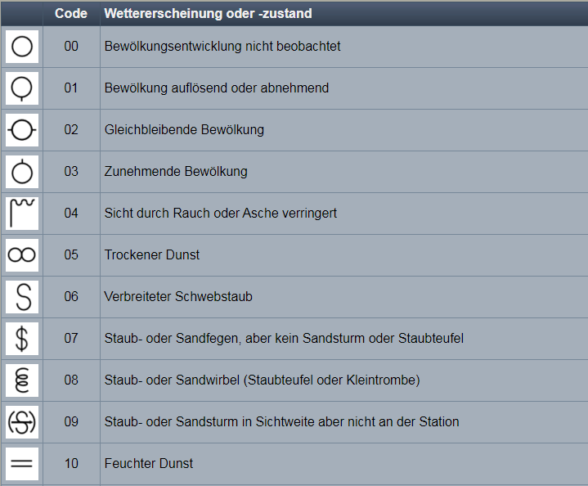
Weather codes (example)

Slide 5

Preliminary analysis

Slide 6
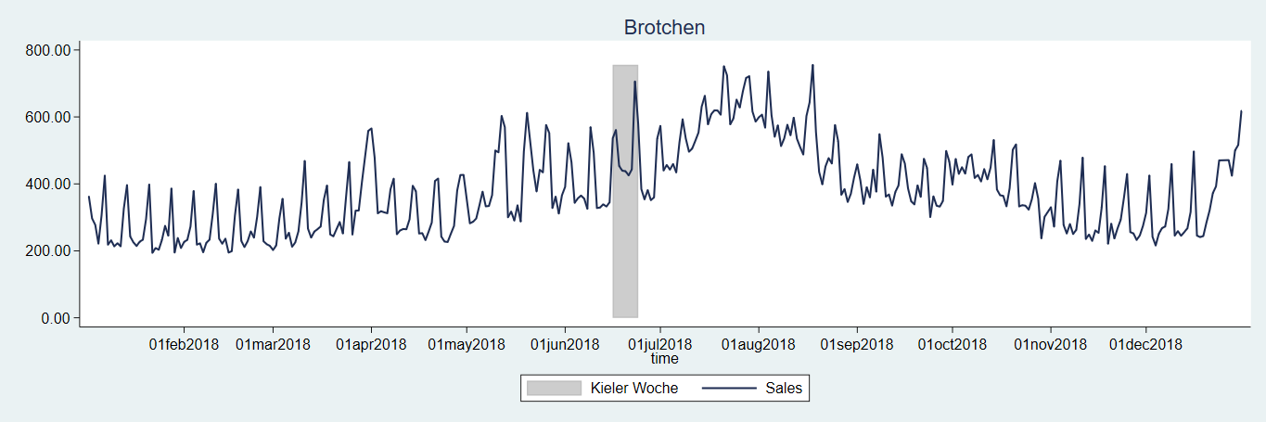
Bakery Items for 2018
Six bakery item: Brot, Brötchen, Croissant, Konditorei, Kuchen, Saisonbrot
6 years
Kieler Woche

Slide 7
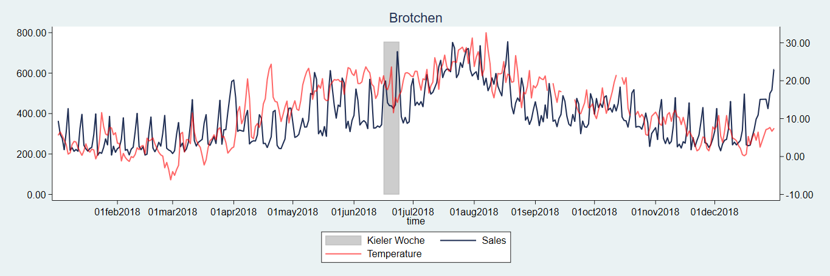
Recorded Factors – Temperature
Recorded factors data: Temperature, Cloudiness, Wind speed, Weather code and Kieler Woche
Best correlation between Brötchen and the temperature: 0.6512

Slide 8
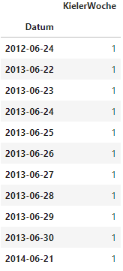
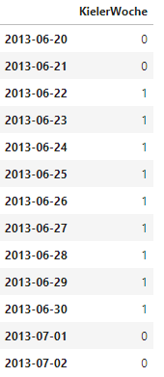
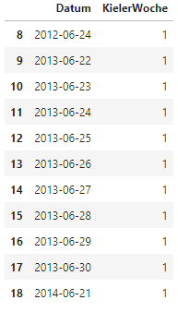

Data preparation
Data workflow
Set index
Fill missing index values
Read .csv file and convert to panda dateFrame

Slide 9
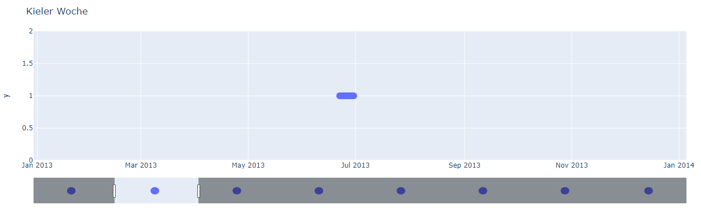
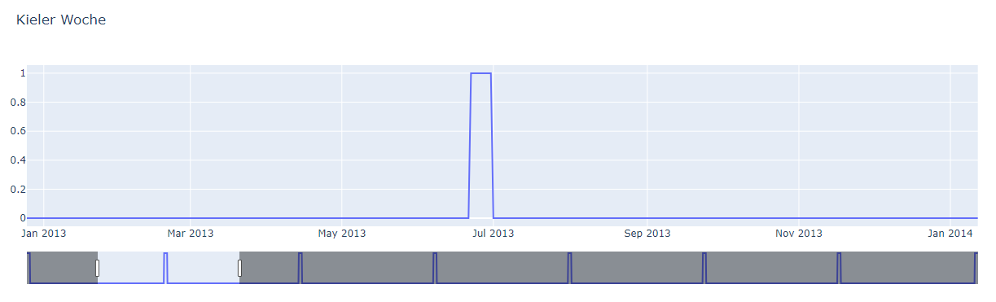
Data preparation
Fill missing index values

Slide 10
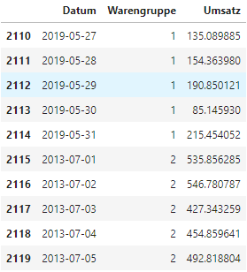
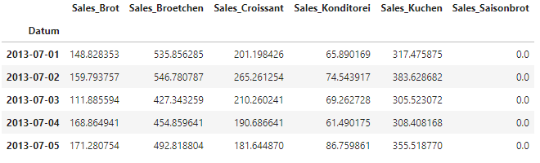
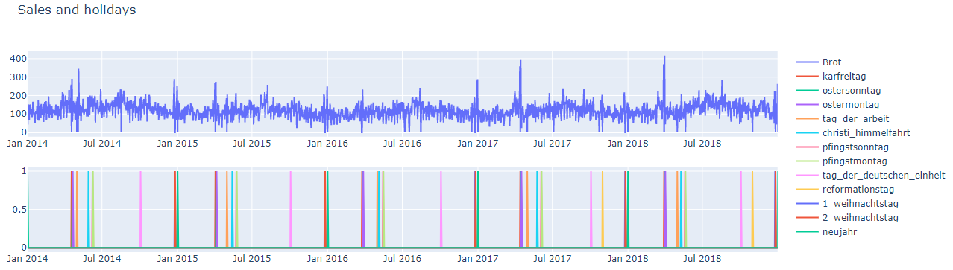
Data preparation
Reorganize data
Convert to categories

Slide 11

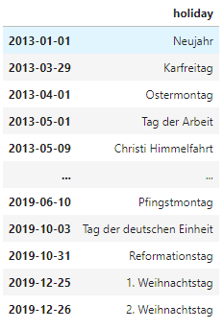
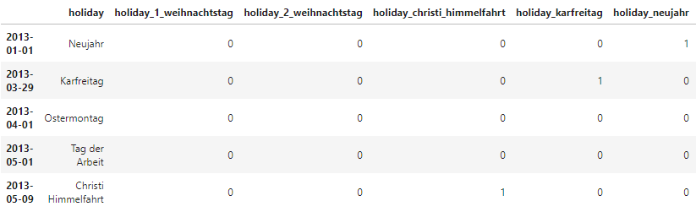
Data preparation
Getting data from the internet
[[{'title': 'Neujahr', 'date': '2013-01-01', 'locs': ['BW', 'BY', 'BE', 'BB', 'HB', 'HH', 'HE', 'MV', 'NI', 'NW', 'RP', 'SL', 'SN', 'ST', 'SH', 'TH']},
{'title': 'Karfreitag', 'date': '2013-03-29', 'locs': ['BW', 'BY', 'BE', 'BB', 'HB', 'HH', 'HE', 'MV', 'NI', 'NW', 'RP', 'SL', 'SN', 'ST', 'SH', 'TH']},
{'title': 'Ostermontag', 'date': '2013-04-01', 'locs': ['BW', 'BY', 'BE', 'BB', 'HB', 'HH', 'HE', 'MV', 'NI', 'NW', 'RP', 'SL', 'SN', 'ST', 'SH', 'TH']},
{'title': 'Tag der Arbeit', 'date': '2013-05-01', 'locs': ['BW', 'BY', 'BE', 'BB', 'HB', 'HH', 'HE', 'MV', 'NI', 'NW', 'RP', 'SL', 'SN', 'ST', 'SH', 'TH']},
{'title': 'Christi Himmelfahrt', 'date': '2013-05-09', 'locs': ['BW', 'BY', 'BE', 'BB', 'HB', 'HH', 'HE', 'MV', 'NI', 'NW', 'RP', 'SL', 'SN', 'ST', 'SH', 'TH‘]},
{'title': 'Pfingstmontag', 'date': '2013-05-20', 'locs': ['BW', 'BY', 'BE', 'BB', 'HB', 'HH', 'HE', 'MV', 'NI', 'NW', 'RP', 'SL', 'SN', 'ST', 'SH', 'TH']},
{'title': 'Tag der deutschen Einheit', 'date': '2013-10-03', 'locs': ['BW', 'BY', 'BE', 'BB', 'HB', 'HH', 'HE', 'MV', 'NI', 'NW', 'RP', 'SL', 'SN', 'ST', 'SH', 'TH‘]},
{'title': '1. Weihnachtstag', 'date': '2013-12-25', 'locs': ['BW', 'BY', 'BE', 'BB', 'HB', 'HH', 'HE', 'MV', 'NI', 'NW', 'RP', 'SL', 'SN', 'ST', 'SH', 'TH']},
{'title': '2. Weihnachtstag', 'date': '2013-12-26', 'locs': ['BW', 'BY', 'BE', 'BB', 'HB', 'HH', 'HE', 'MV', 'NI', 'NW', 'RP', 'SL', 'SN', 'ST', 'SH', ‚TH]}]
Transform data to python format
{'2013-01-01': 'Neujahr', '2013-03-29': 'Karfreitag', '2013-04-01': 'Ostermontag', '2013-05-01': 'Tag der Arbeit‘,
'2013-05-09': 'Christi Himmelfahrt', '2013-05-20': 'Pfingstmontag', '2013-10-03': 'Tag der deutschen Einheit‘,
'2013-12-25': '1. Weihnachtstag', '2013-12-26': '2. Weihnachtstag‘}
Convert to
panda dataFrame
Convert to mapping values

Slide 12
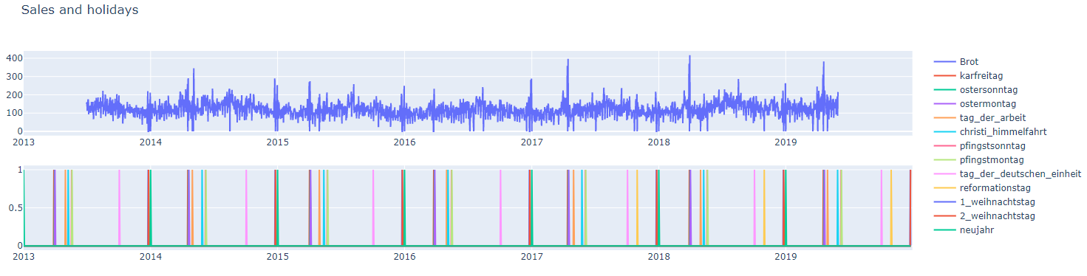
Data preparation
Cutting edges
Cut left edge
Cut right edge

Slide 13
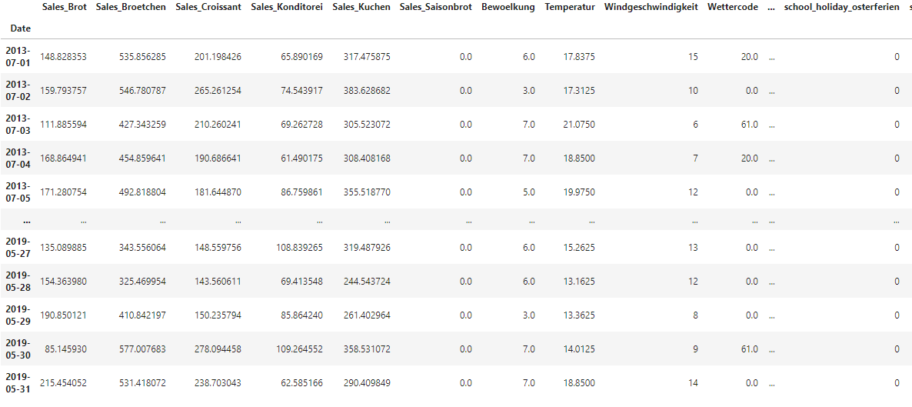
Data preparation
Data workflow
Merge all data
Write to .csv file

Slide 14
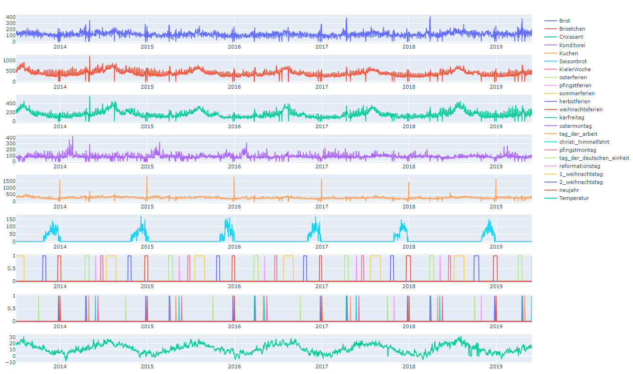
Data preparation

Slide 15


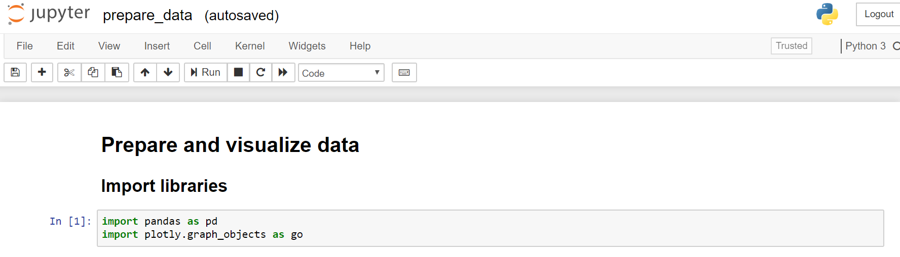
Technical environment
We used both Anaconda and Colab
Anaconda with Jupyter Notbook:
Better access to the data files
Has more errors than Colab because many tool are not preinstalled
Run the analysis locally
Jupyter Notebook is editable through the browser

Slide 16
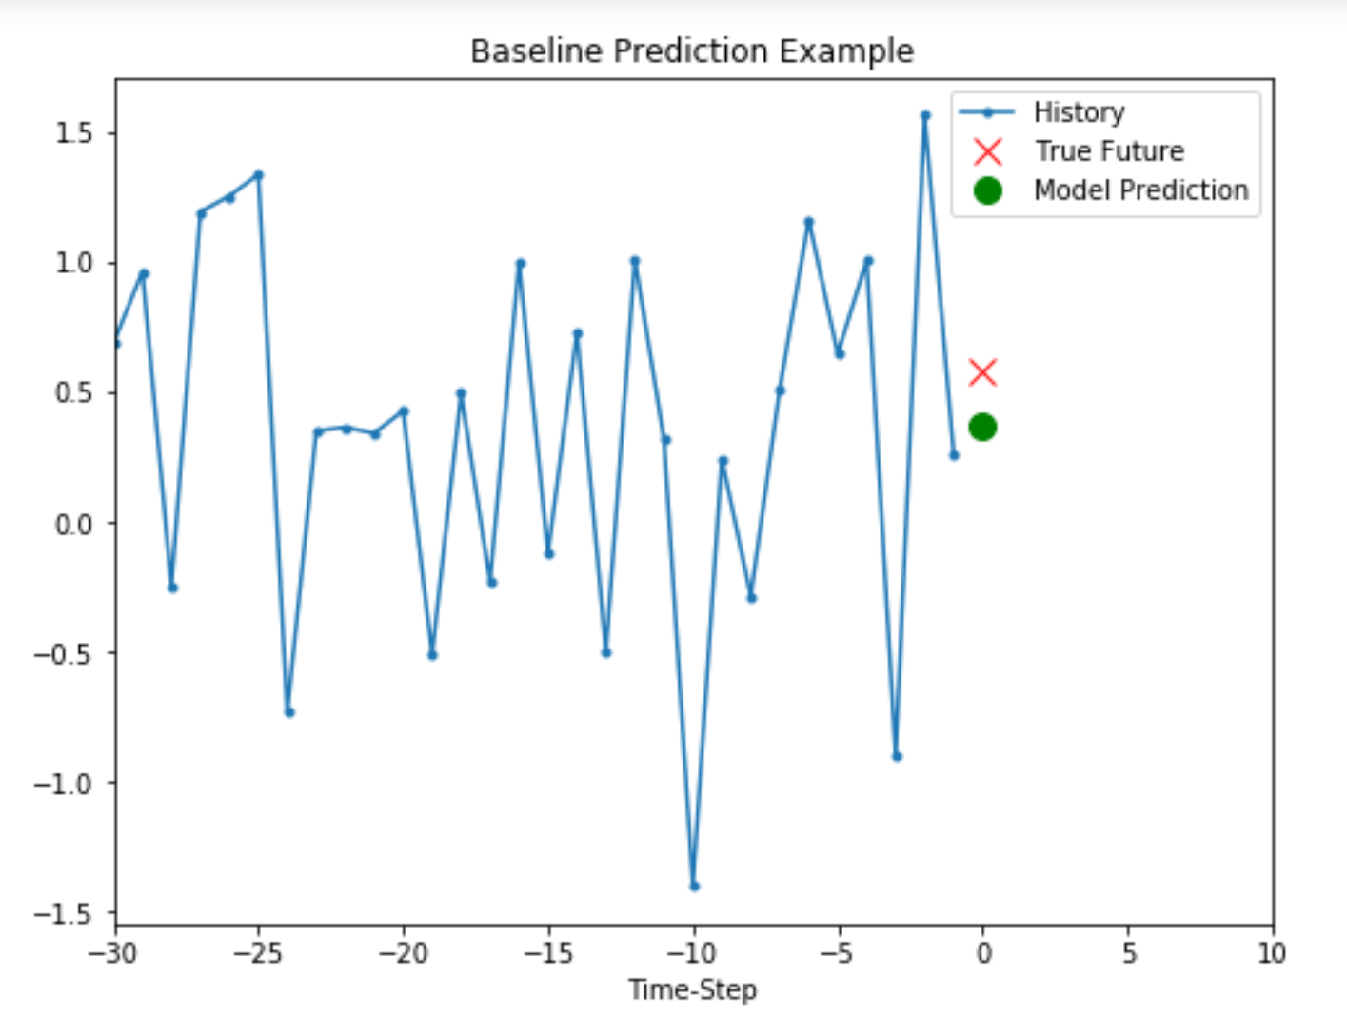
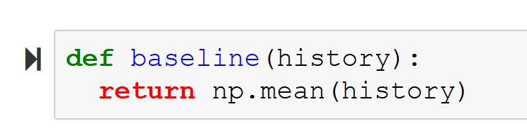
Univariate prediction – Baseline
Baseline prediction
Mean of the window values

Slide 17
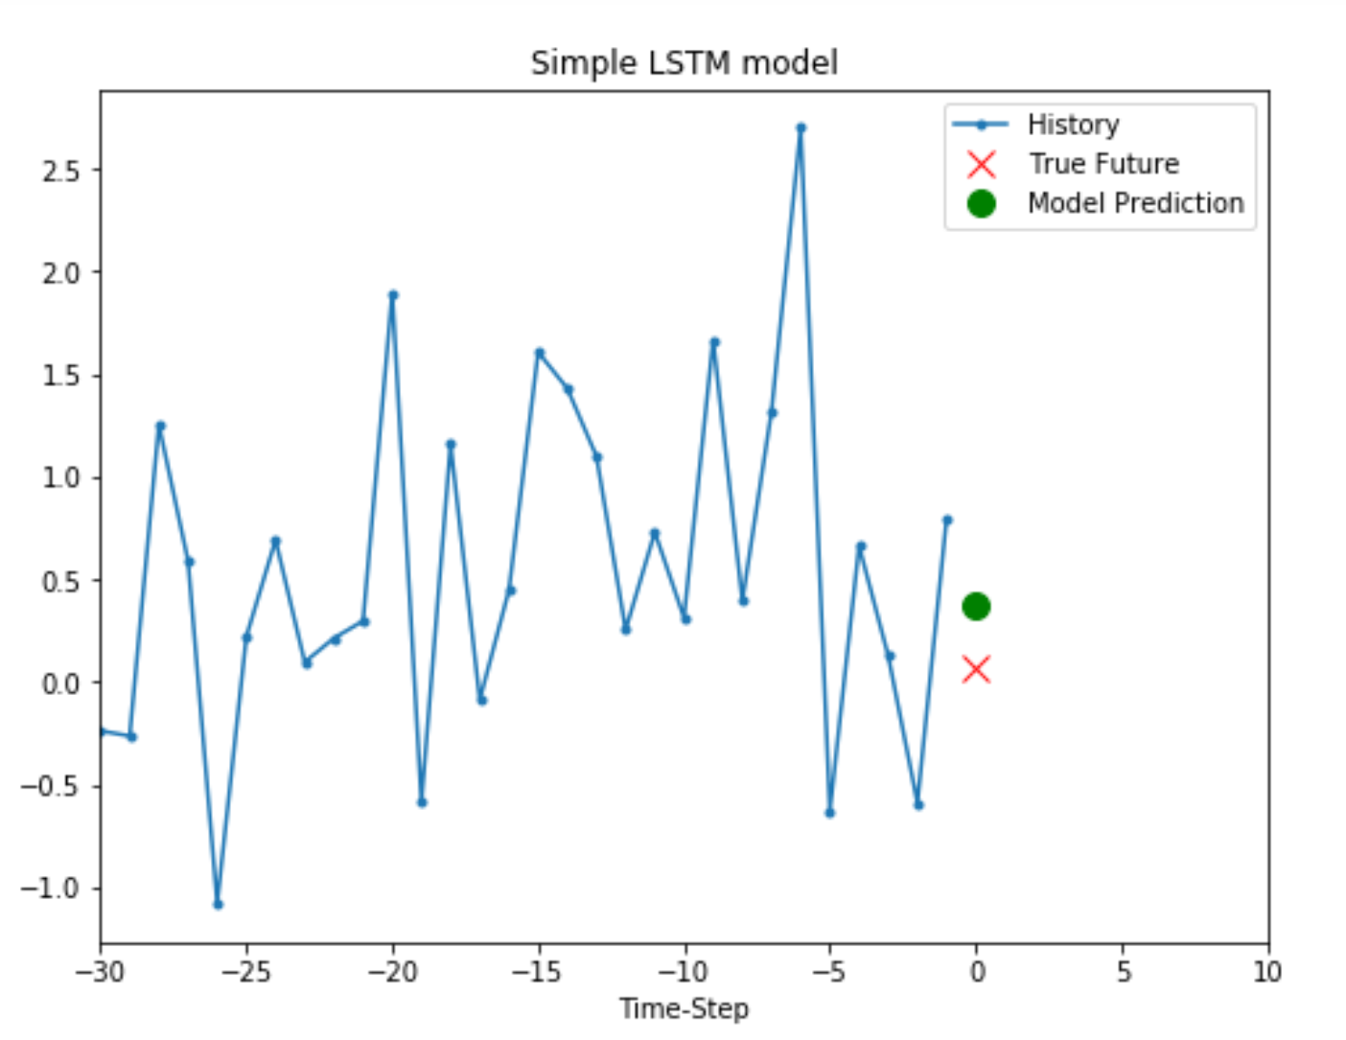
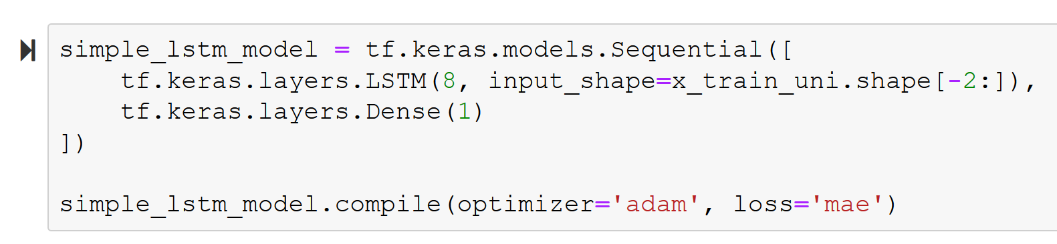
Univariate Prediction - LSTM
Total entries: 2115 days
Training: 1500 days
Validation: 615 days
Epochs: 5
Loss: 0.6803
Validation Loss: 0.7707

Slide 18
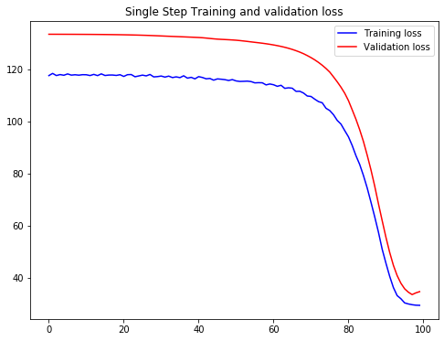
Multivariate Prediction of Brot Sales
single_step_model = tf.keras.models.Sequential() single_step_model.add(tf.keras.layers.LSTM(64, input_shape=x_train_single.shape[-2:]))
single_step_model.add(tf.keras.layers.Dense(1))
single_step_model.add(tf.keras.layers.Lambda(lambda x: x * 1))
lr_schedule = tf.keras.callbacks.LearningRateScheduler(lambda epoch: 1e-8 * 10**(epoch / 20))
optimizer = tf.keras.optimizers.SGD(lr=1e-3, momentum=0.9)
single_step_model.compile(loss=tf.keras.losses.Huber(), optimizer=optimizer,metrics=["mae"])
Features considered:
Temperature,
Weekday,
cloudiness,
Wind strength,
KielerWoche,
month,
Day of the month

Slide 19
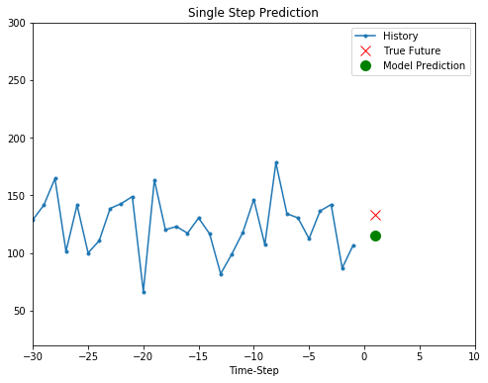
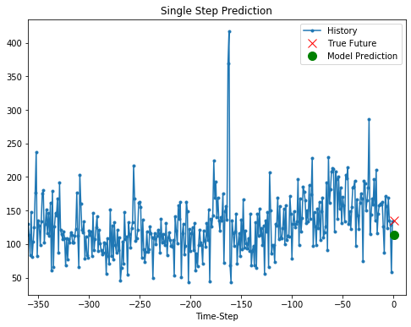
Multivariate Prediction of Brot Sales
True Future Value : 132.7457
Predicted Value : 114.92391
18 € gap

Slide 20
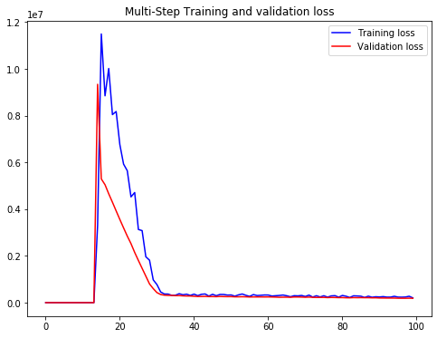
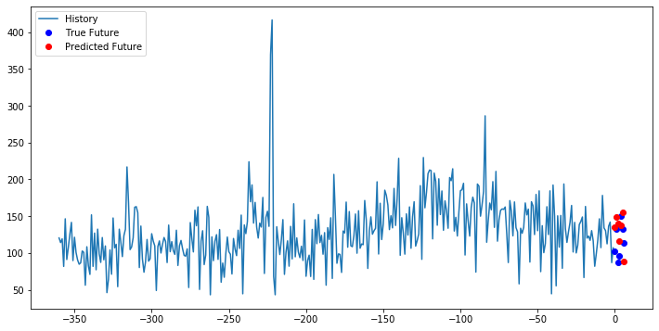
Multivariate Prediction of Brot Sales – Multiple steps
Features considered = Temperature, Weekday, cloudiness, Wind strenght, KielerWoche, month, day
7 steps prediction
True Future Values : [101.9948 132.7457 87.58441 96.07465 150.0232 132.0612 113.6098 ]
Predicted Values : [135.1966 148.8698 139.7381 116.4552 137.4950 154.8985 88.04076]

Slide 21
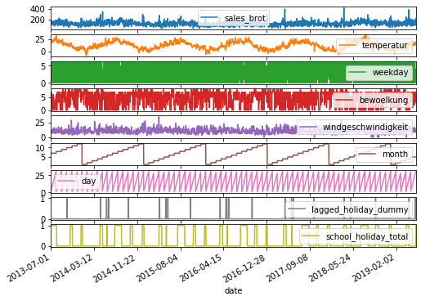
Multivariate Prediction of Brot Sales (with holidays)
Features considered :
Temperature
Weekday
cloudiness
Wind strenght
KielerWoche
month
Day of the month
school holidays (dummy)
lagged(t-1) national holidays(dummy)

Slide 22
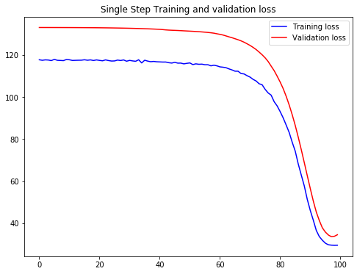
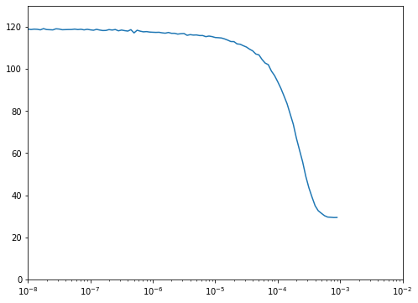
Multivariate Prediction of Brot Sales (with holidays)
single_step_model = tf.keras.models.Sequential() single_step_model.add(tf.keras.layers.LSTM(64, input_shape=x_train_single.shape[-2:]))
single_step_model.add(tf.keras.layers.Dense(1))
single_step_model.add(tf.keras.layers.Lambda(lambda x: x * 1))
lr_schedule = tf.keras.callbacks.LearningRateScheduler(lambda epoch: 1e-8 * 10**(epoch / 20))
optimizer = tf.keras.optimizers.SGD(lr=1e-3, momentum=0.9)
single_step_model.compile(loss=tf.keras.losses.Huber(), optimizer=optimizer,metrics=["mae"])

Slide 23
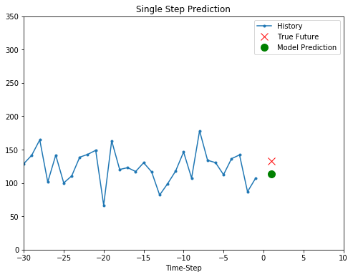

Multivariate Prediction of Brot Sales (with holidays)
True Future Value : 132.7457
Predicted Value : 113.19249
19 € gap

Slide 24
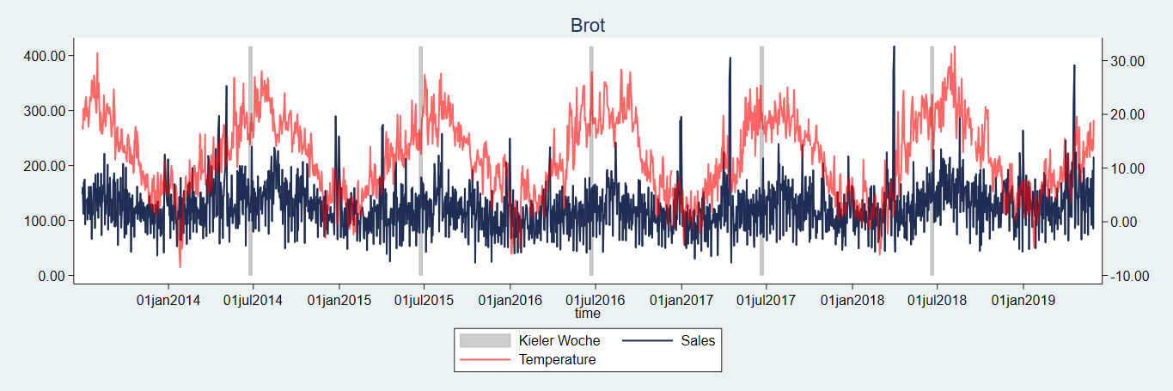
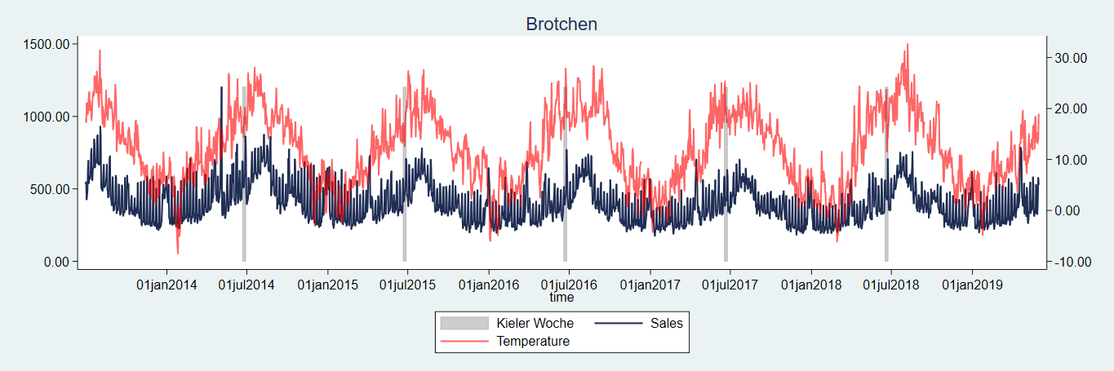
Multivariate Prediction of Brotchen Sales (with holidays)
Correlations of Brot and Broetchen with temperature troughout the 6 years

Slide 25
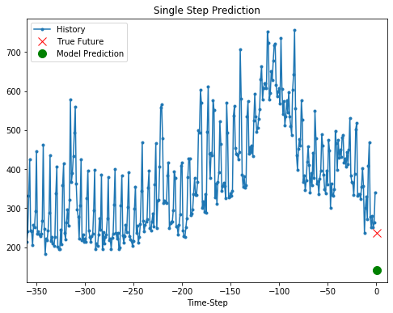
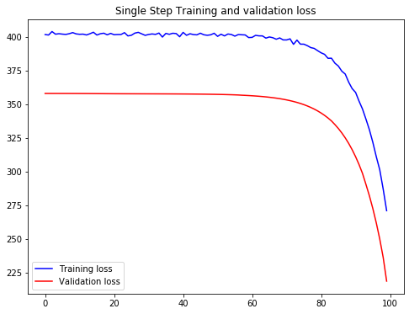
Multivariate Prediction of Brotchen Sales (with holidays)
True Future Value : 235.4168
Predicted Value : 141.0063

Slide 26
Repository
Repository link: bitbucket.org/opencampus-tensorflow/bakery-sales-prediction.git

Slide 27
Challenges and Problems
Lack of experience with Python
Short window of history, we changed from 60 days to 365
Long calculation time (~100)
Technical problems with committing and pushing files to Bitbucket
Troubles with Anaconda and installing packages

